Slide 1
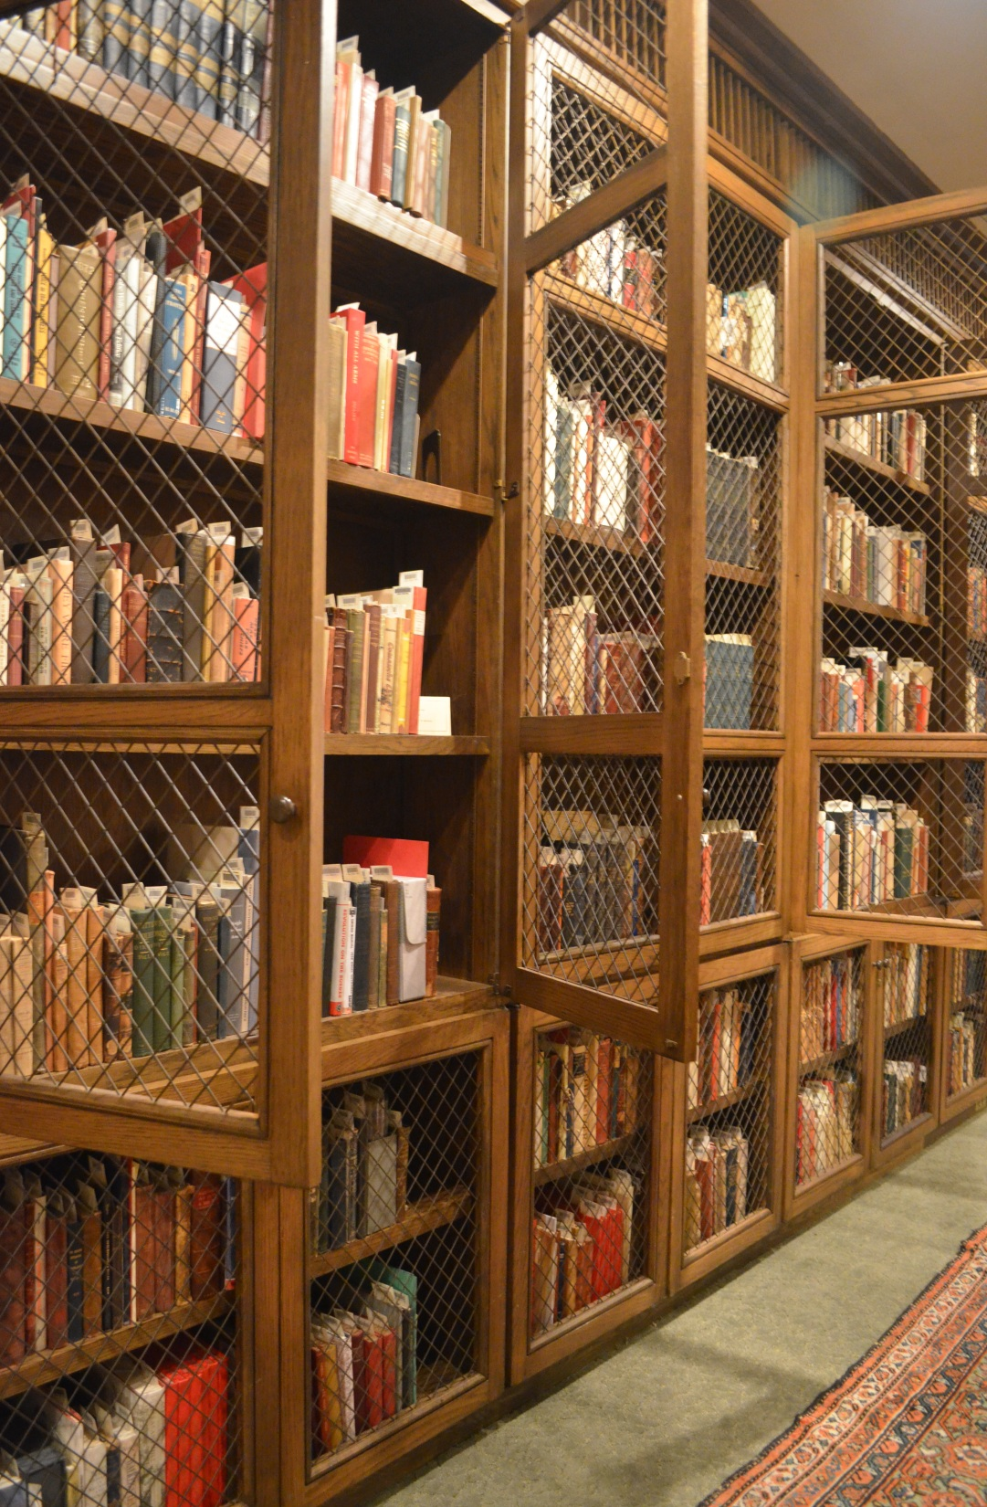
The Art of Discovery
Helping Students Find Inspiration in Unlikely Places
Anne Jumonville &
Dr. Kelly Grey Carlisle,
Trinity University
LOEX 5/10/14

Slide 2
Why?

Slide 3
Creative Nonfiction
Factually accurate prose about real events, people, and phenomena made more vivid and compelling through the use of literary techniques from fiction and poetry.
Memoir, personal writing, nature writing, literary journalism, etc.

Slide 4
Research in Creative Nonfiction
Content
Literary Craft/”Creative”
What the essay or book is about.
Provides essential information for writer and reader.
Facts used to build setting, characterization, etc.
Used to engage readers’ interest.

Slide 5
Research to Inspire
Works in poetry and fiction, as well as other art forms.
Reading research and information learned through it can inspire new creative work or help a writer make unexpected, fresh connections in an existing work.
Facts can serve as metaphors or images
Research can create new connections or deepen understanding
Creates “Aha!” moments for writer and reader.

Slide 6
Inspiration and Research
Developing the habits of a writer can make inspiration more likely to happen.
Reading, browsing in the library, and paying attention to one’s surrounding are all habits that encourage inspiration.
Inspiration is a happy accident, less likely to happen through conscious, focused searching.

Slide 7
Goals for library visit
Overcome student resistance to reading research.
Change student perceptions of research as uncreative drudgery.
Help students to experience inspiration and make happy discoveries through reading research.
Make the library an exciting place.

Slide 8
Against the (information literacy) grain

Slide 9
Information literacy guidelines* often…
Assume a known information “need”
Value efficiency and clear end goals/products
Prioritize strategic searching
Emphasize the development of expertise in scholarly forms/formats
Aim at what’s assessable
*Association of College and Research Libraries. “Information Literacy Competency Standards for Higher Education.” January, 2000. http://www.ala.org/acrl/standards/informationliteracycompetency.
ACRL Information Literacy Competency Standards for Higher Education Task Force. “Framework for Information Literacy for Higher Education.” Draft. February, 2014. http://acrl.ala.org/ilstandards/.

Slide 10
Other approaches (not as well integrated in IL pedagogy)
Information Science research on experiences of serendipity, inspiration; behavior and information seeking habits of artists*
Library Science research on the library as a place for artistic/creative process and discovery**
Creative Writing pedagogies
*Hemmig, William. "An Empirical Study of the Information-Seeking Behavior of Practicing Visual Artists." Journal of Documentation 65.4 (2009): 682-703.
**Aurand, Martin. "Teaching and Learning with Collections: The Library as a Site for Exploration and Inspiration." Art Documentation: Bulletin of the Art Libraries Society of North America 30.1 (2011): 12-20.

Slide 11
Into the Library
Treasury!

Slide 12
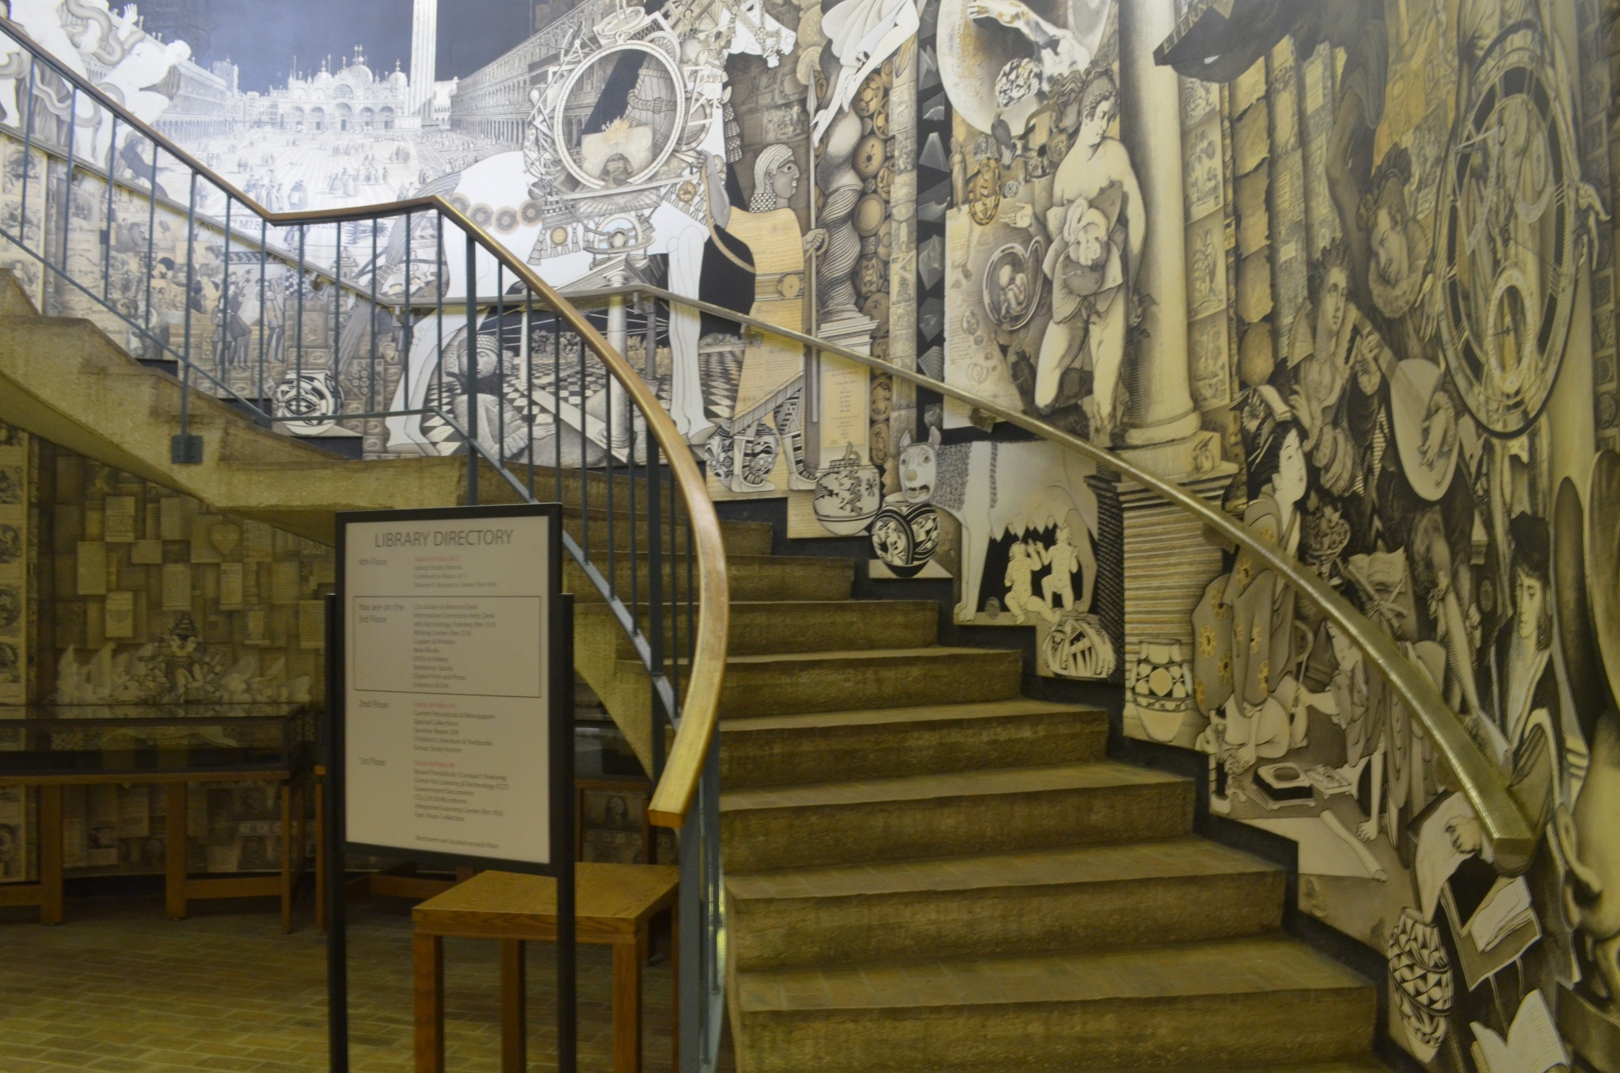

Slide 13
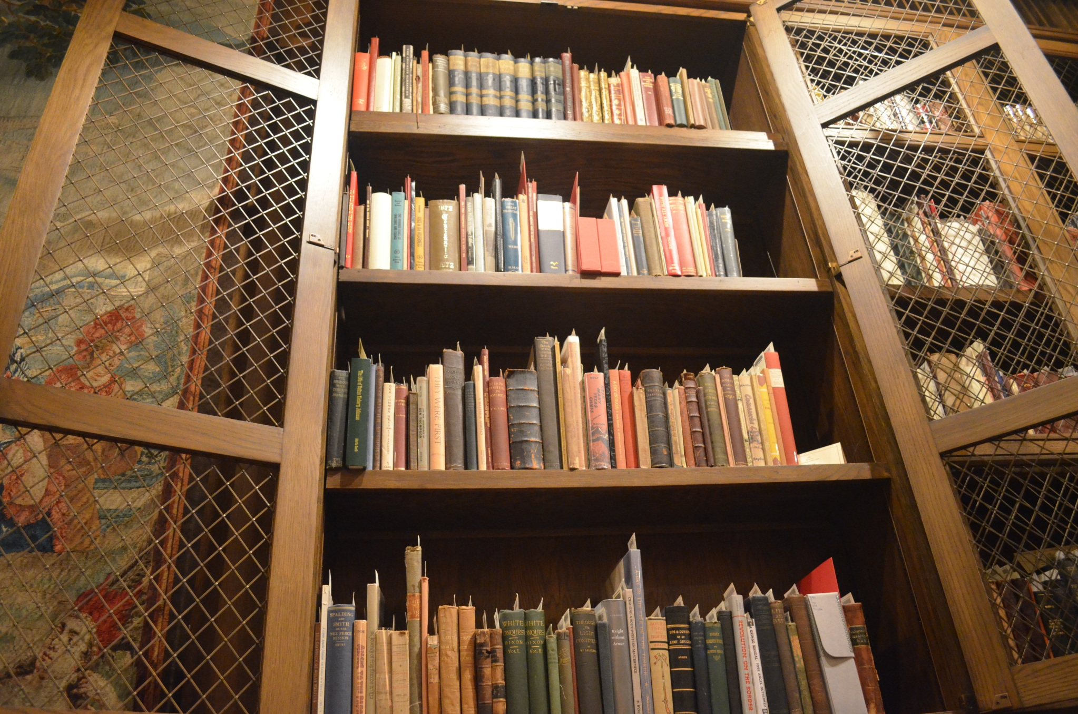

Slide 14
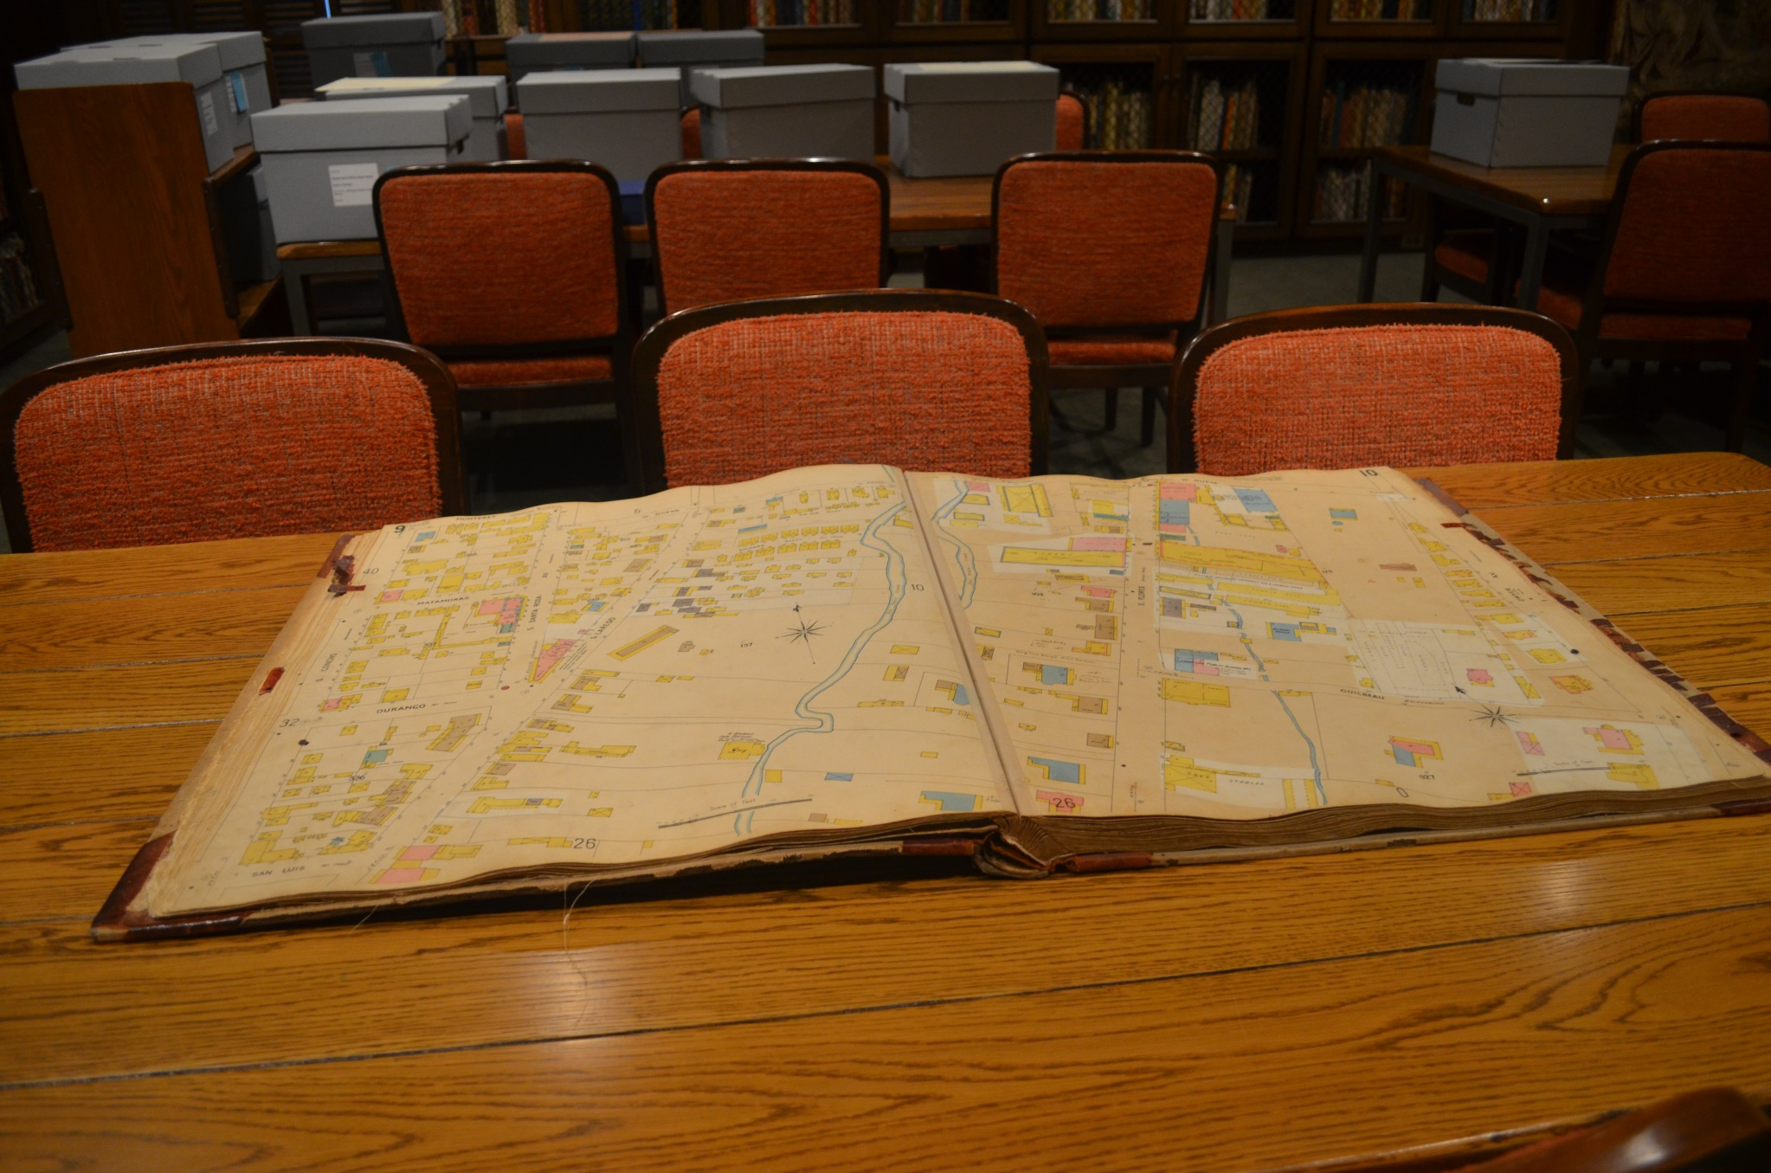

Slide 15
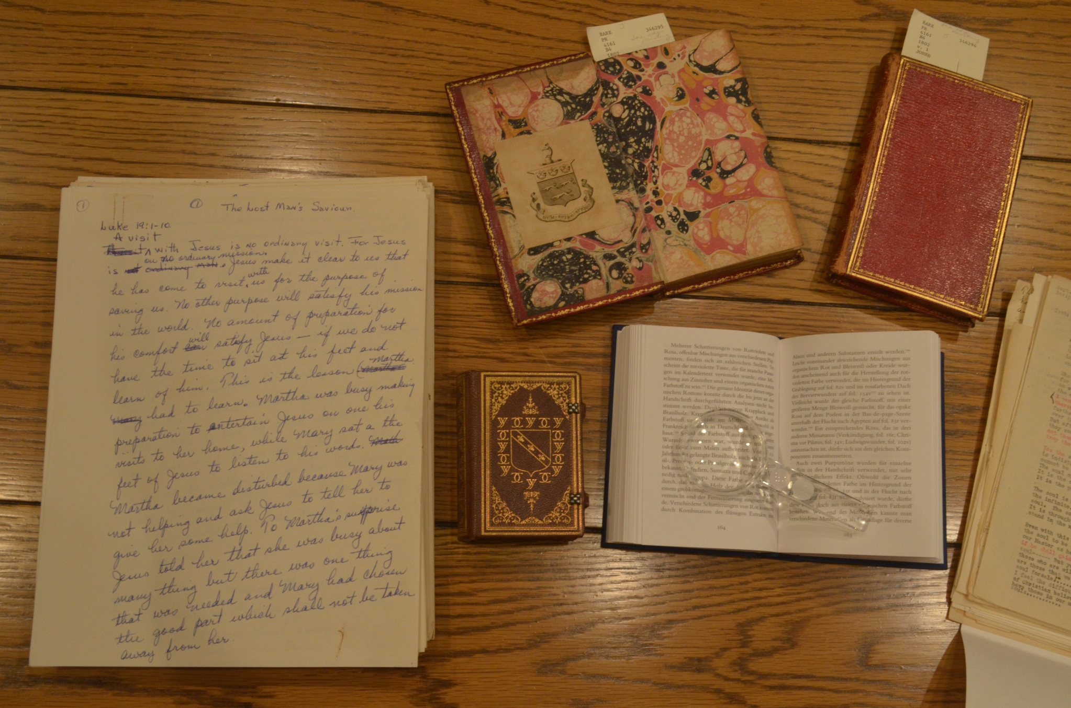

Slide 16
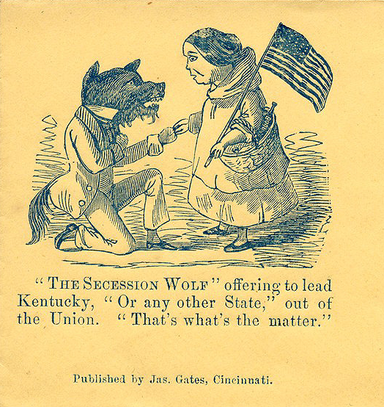
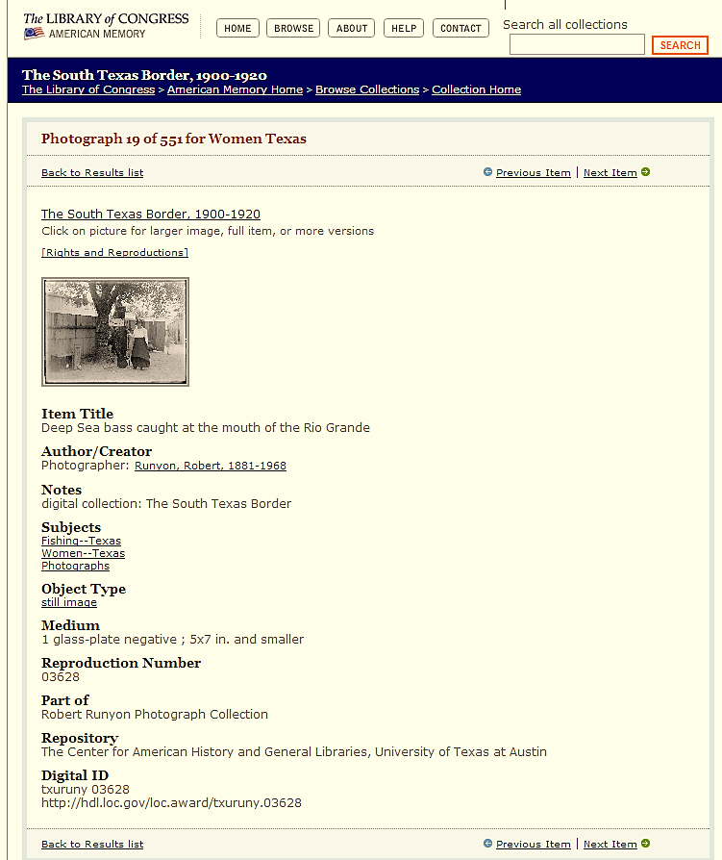
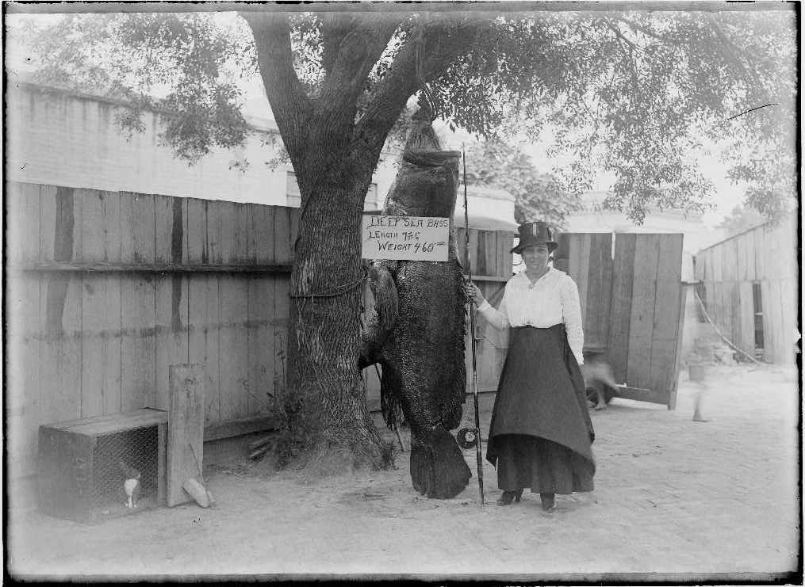

Slide 17
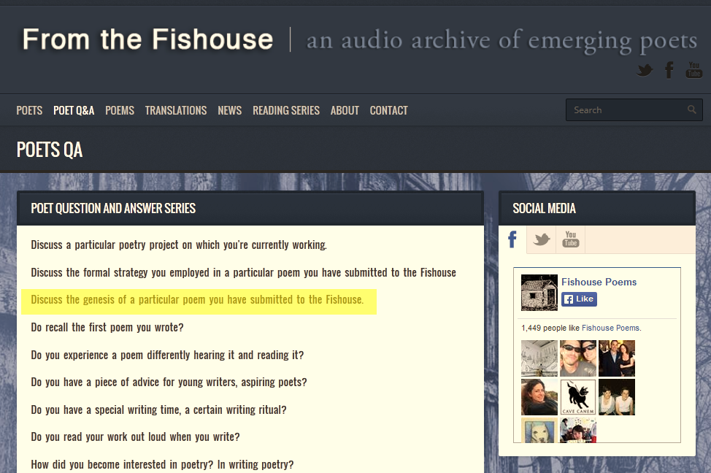
From a family story…
From something I read…
I was interested to learn…

Slide 18
In the classroom

Slide 19
Enacting Inspiration
Read examples of research-driven texts before and after library visit. Point out presence of research when less obvious.
Small stakes exercises that reinforce learning from library session.
Feedback that encourages including research where fitting in larger creative projects, like essay drafts.

Slide 20
Reinforcement exercises
Exercise for inspiration (handout “Exercise 3”)
  Due at class period following library session.
  Encourages students to “geek out” without the usual formal requirements of citation and source incorporation.
Exercise for revision (handout “Exercise 6”)
  Due after first long essay draft, a few weeks after session.
  Reviews library session material through online video.
  Encourages students to incorporate research into an extant essay draft as a form of revision.

Slide 21
Assessment Strategies

Slide 22
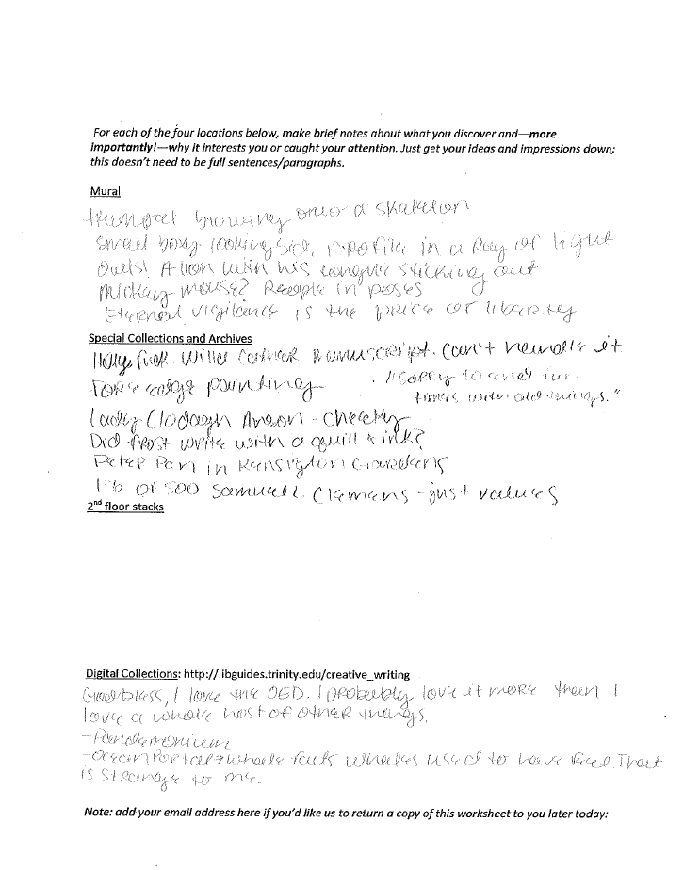
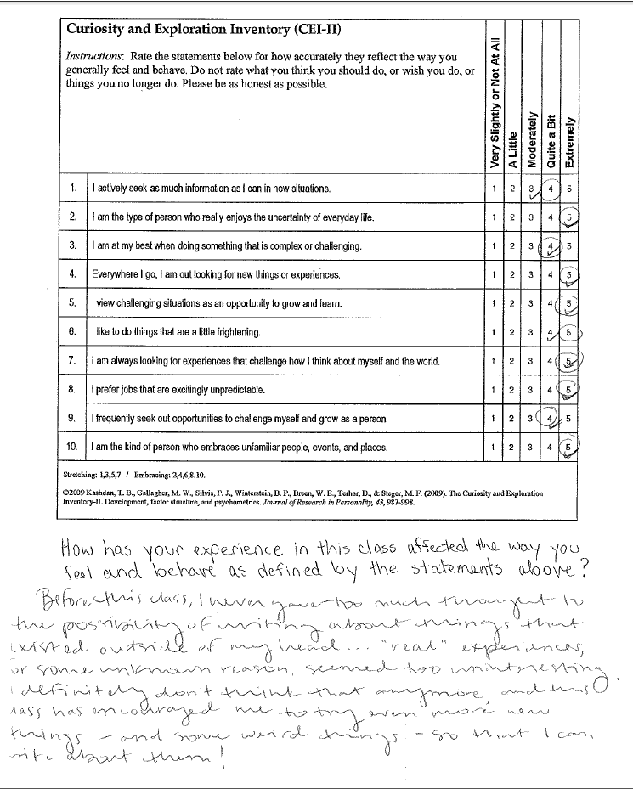
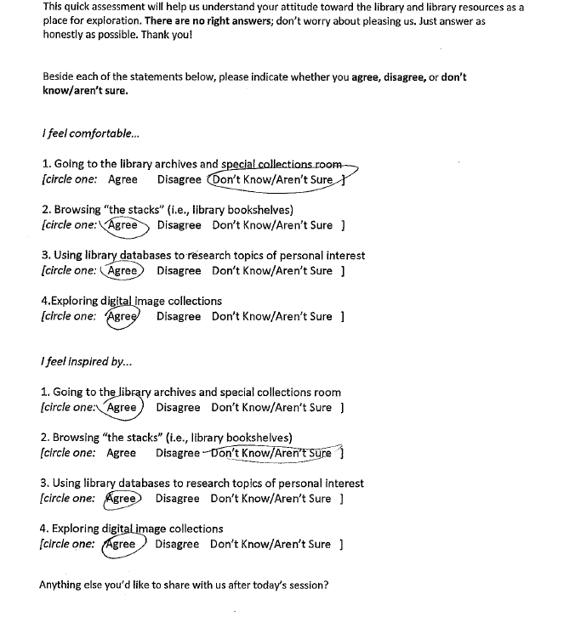
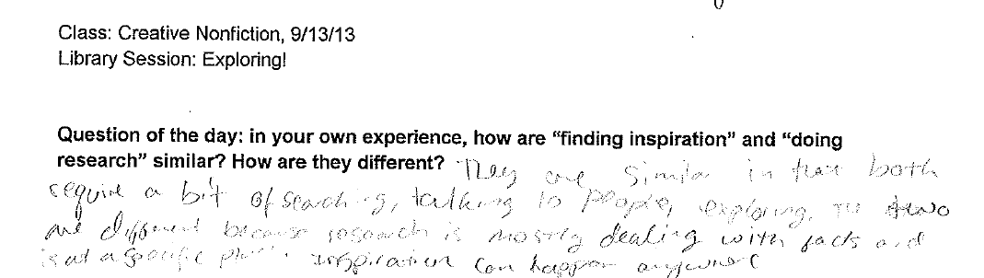

Slide 23
Research vs Inspiration
  Systematic
  “Information needs”
  Fact-based
  Goal-oriented
Sporadic
Stumbled upon
Emotional attachment
Sparks further interest

Slide 24
Research and Inspiration
(action)
(experience)
  Lead to something new (Discovery)
  Influence each other (Coactivating)
“You can find inspiration while doing research”
““They both tend to require ‘new’ information”
““ Research is a way to further inspiration and ground it in facts”

Slide 25
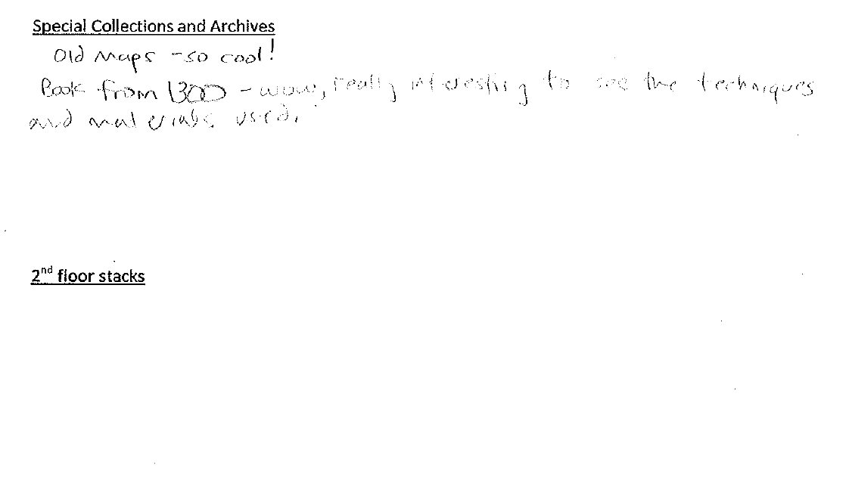
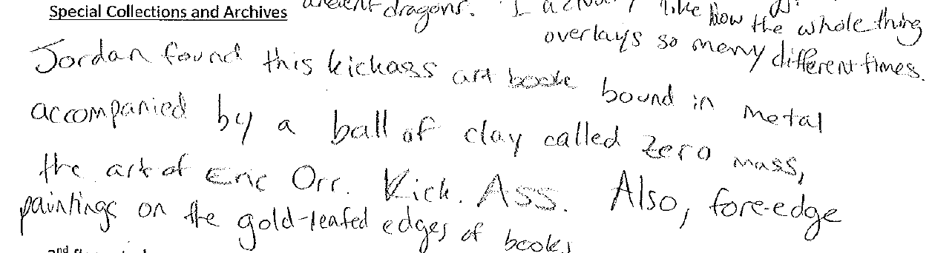
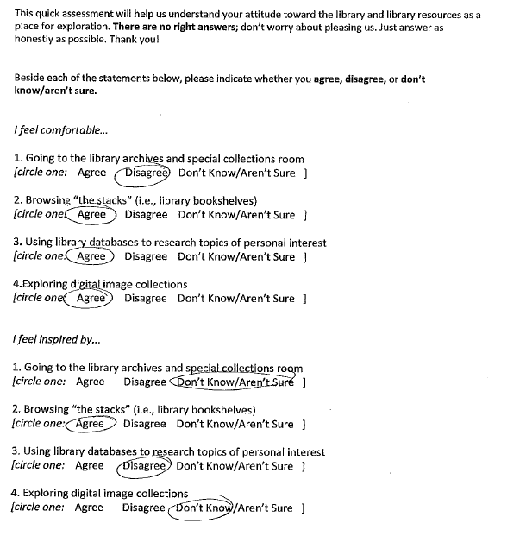
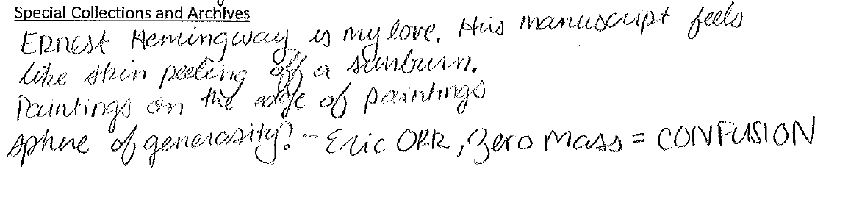
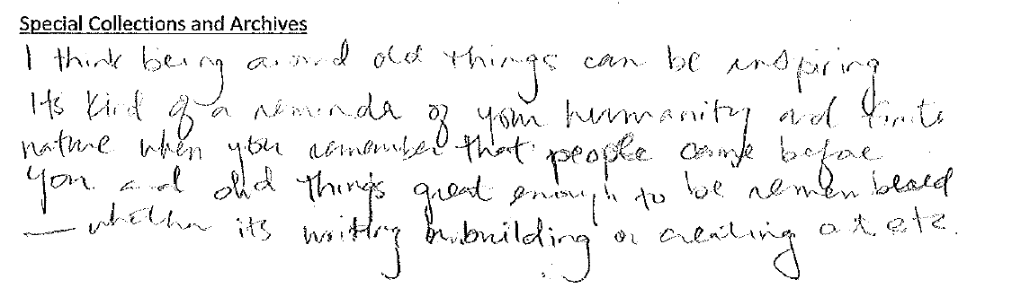
Results

Slide 26
Help dealing with difficult situations (5)
More likely to try new experiences (3)
See the ordinary as extraordinary (3)
More attentive to surroundings (4)

Slide 27
Student Writing

Slide 28
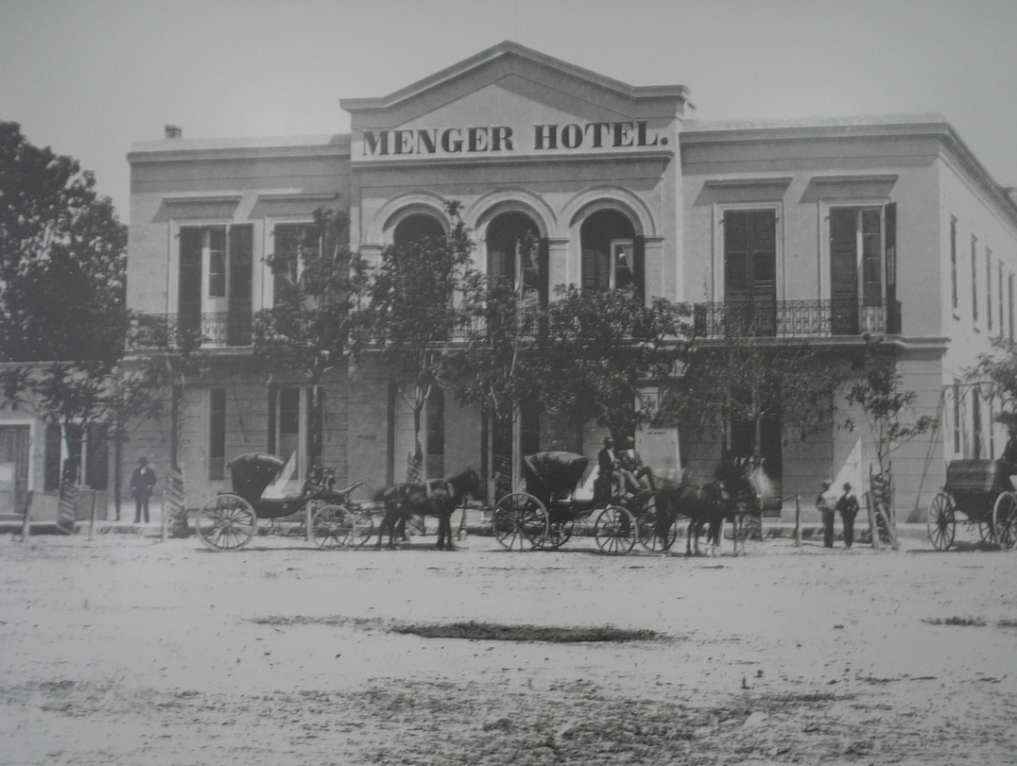
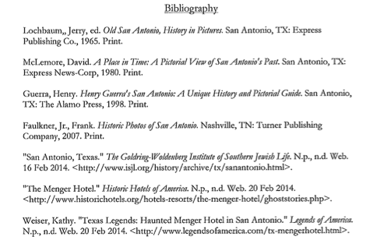
Recreation of a Historical Scene
“Bloodlines” by Student A

Slide 29
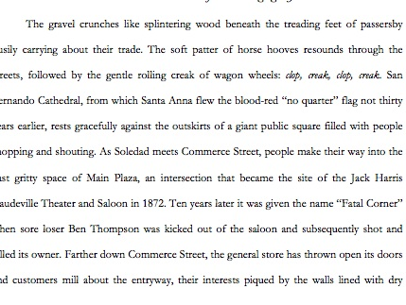
Recreation of a Historical Scene
“Bloodlines” by Student A

Slide 30
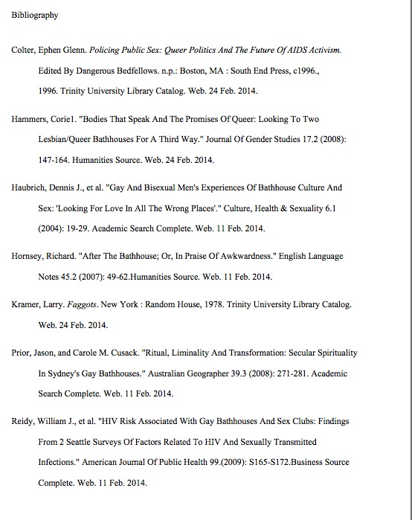
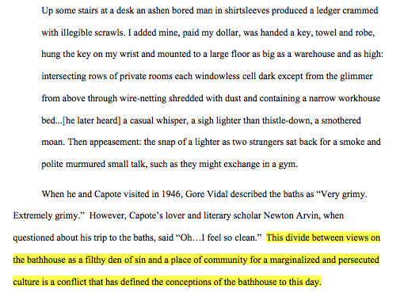
Discovering the Significance of a Topic
“Gay Bathhouse Draft” by Student B

Slide 31
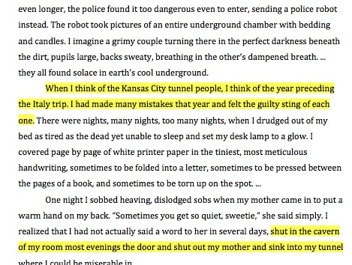
Using Research to Create a Metaphor
“When You Find Yourself In a Hole, Dig for Dear Life” by Student C

Slide 32
Implications for Practice
The library IS a treasury.
You can’t measure curiosity and wonder,* but experimenting with different assessment methods can still be instructive.
Creative nonfiction writing offers an alternative research framework applicable to other courses.
The language and goals of artists and creative writers should be more intentionally included in information literacy pedagogy.
*Jacobs, Heidi L.M. “Minding the Gaps: Exploring the Space Between Vision and Assessment in Information Literacy Work." Communications in Information Literacy 7.2 (2013): n. pag. Web. 9 May 2014.

Slide 33
Thank you!
Questions?

